Slide 1
Inheritance and Overloading in Java
A powerful combination
Mitra Pranoy

Slide 2
Multiple Inheritance

Slide 3
Multiple Inheritance
Multiple Inheritance is a feature of an object-oriented concept, where a class can inherit properties of more than one parent class
Implementation of Multiple Inheritance in Java is not supported by default to avoid several ambiguity issues. One kind of ambiguity is the Diamond Problem.
Java does not support Multiple Inheritance, but we can use Interfaces to achieve the same purpose.
When a class implements multiple interfaces, it inherits the methods and properties defined in each interface. This allows the class to have multiple types of behavior, making it more versatile and adaptable.

Slide 4
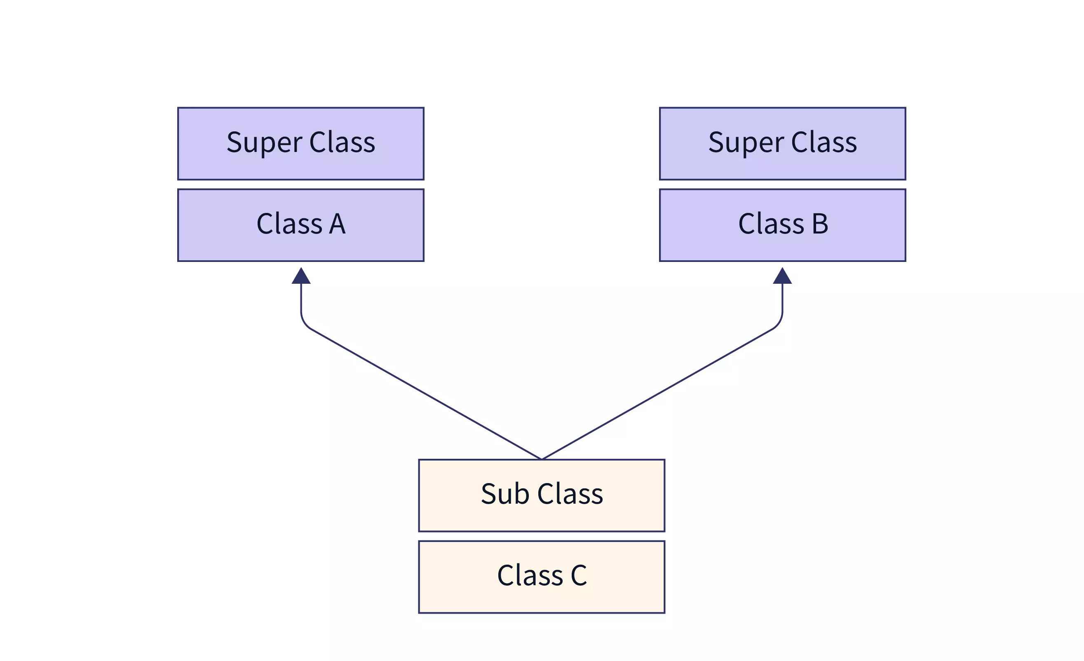
Multiple Inheritance Representation

Slide 5
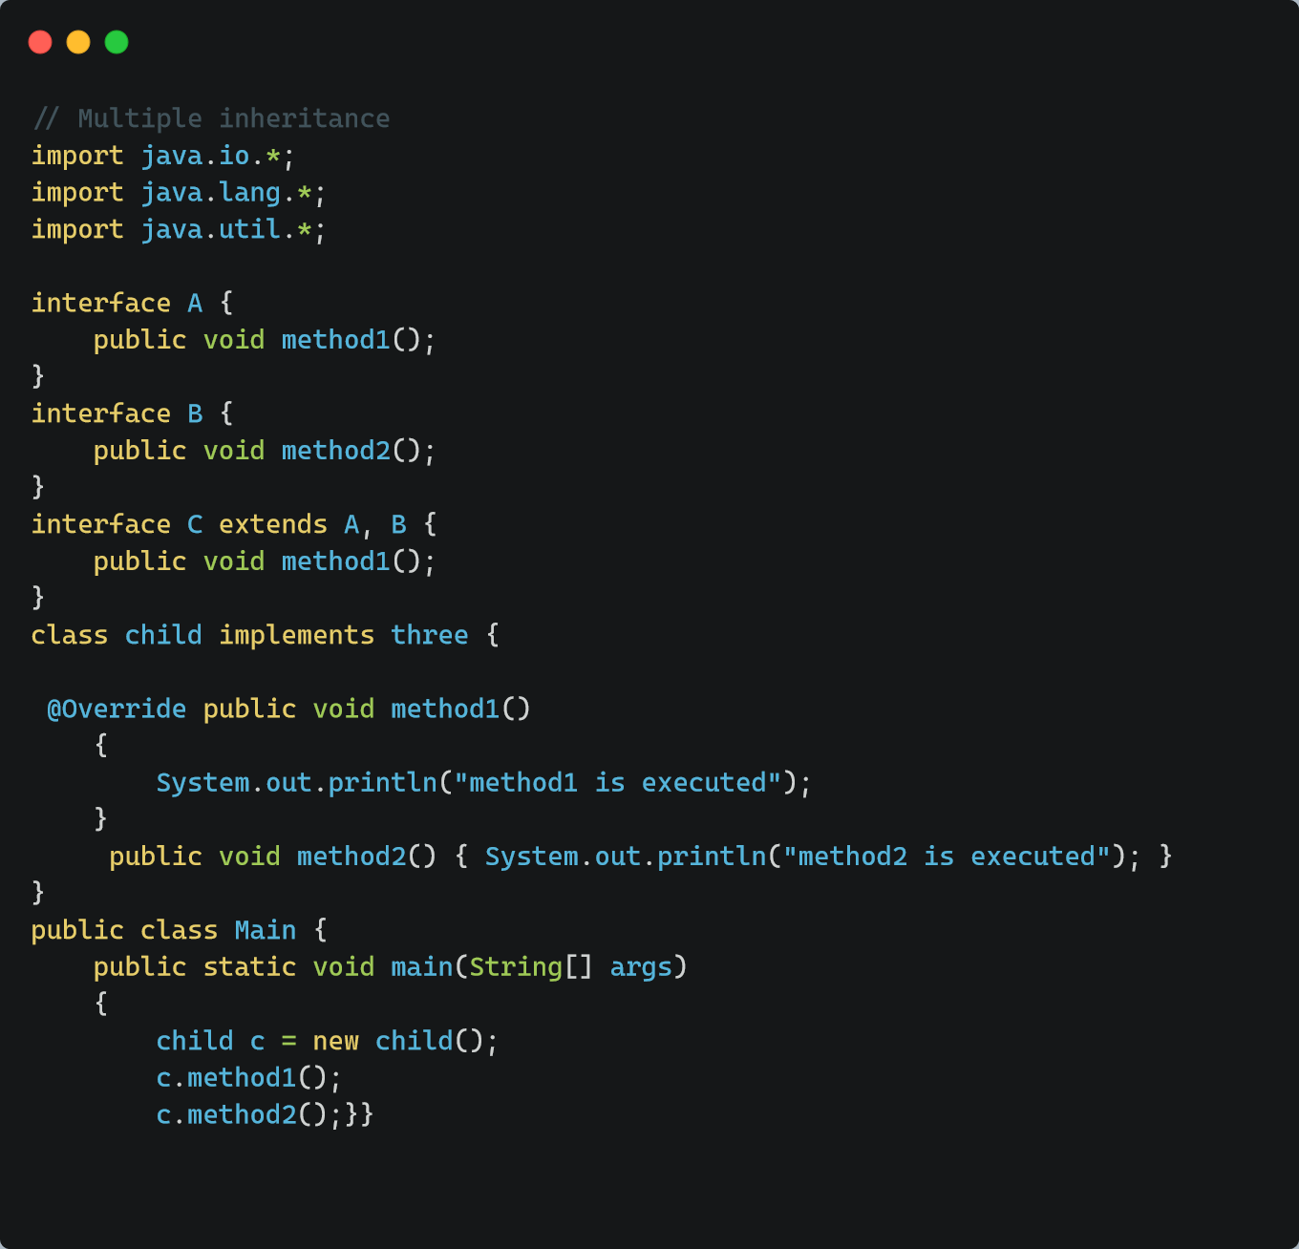

Slide 6
Hierarchical Inheritance

Slide 7
Hierarchical Inheritance
Hierarchical Inheritance is one of the types of inheritance where multiple child classes inherit the methods and properties of the same parent class.
For Hierarchical inheritance to occur, there must be at least two sub-classes that extend (or inherits) the same superclass.
The idea is simple: To use the methods and properties of the parent class instead of creating them again in the sub-class.
This reduces code redundancy. Hence, Hierarchical inheritance ultimately makes the code reusable, less redundant, modular, and more readable.

Slide 8
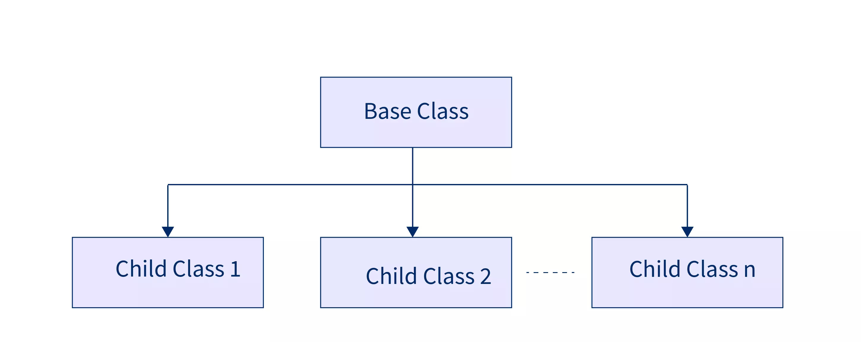
Hierarchical Inheritance Representation

Slide 9
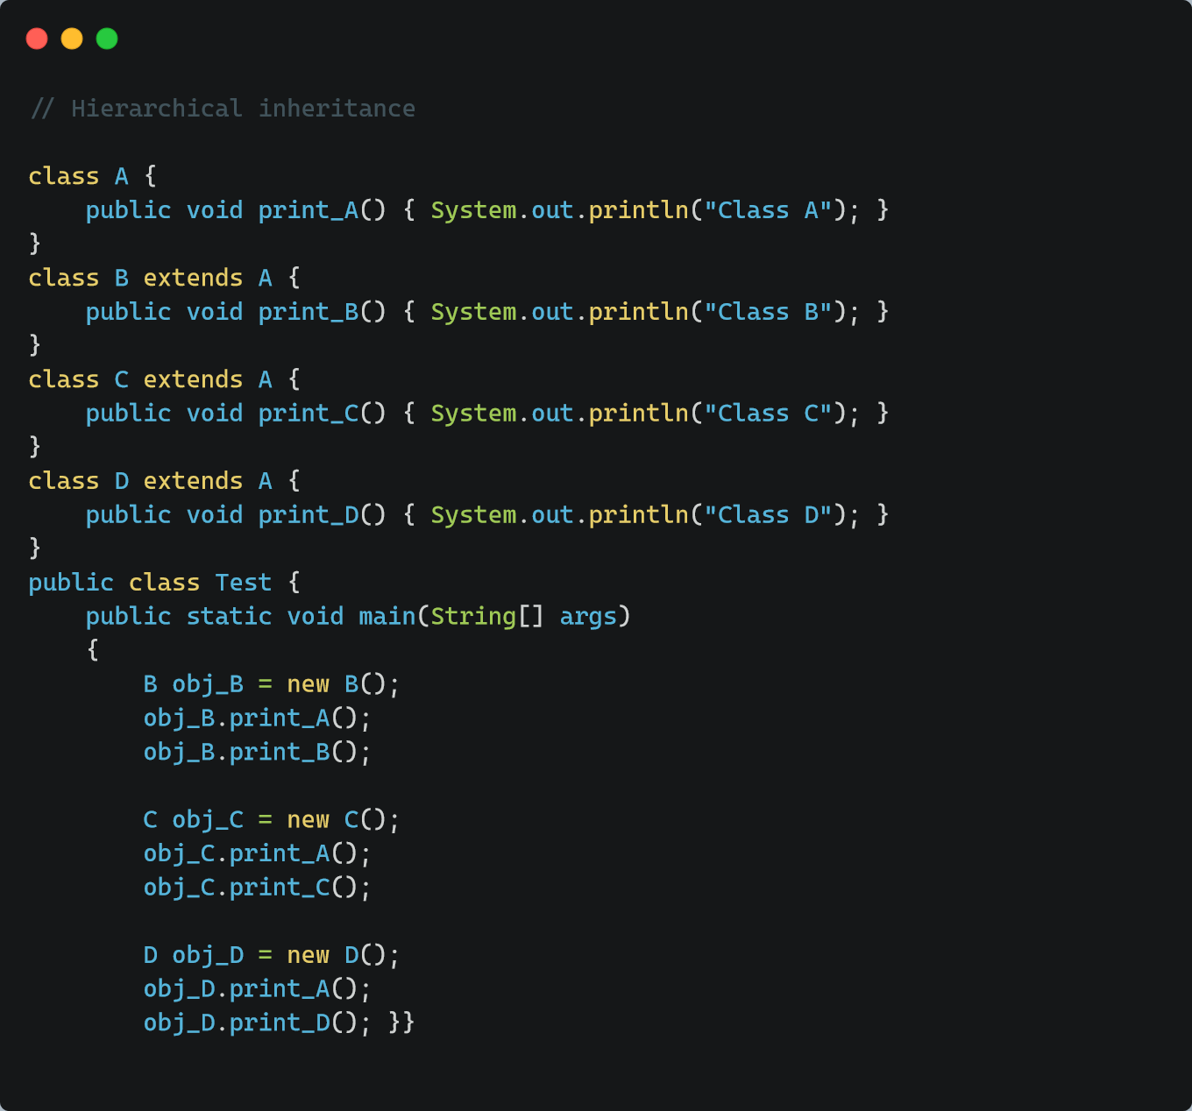

Slide 10
Method Over loading

Slide 11
Method Overloading
If a class has multiple methods having same name but parameters of the method should be different is known as Method Overloading.
In method overloading, we can create methods having the same name but differ in the type, number, and/or sequence of parameters.
When an overloaded method is invoked, Java uses the type, number, and/or, sequence, or arguments as its guide to determine which version of the overloaded method to call.
It is used when different objects are required to perform a similar set of tasks but use different input parameters.
Java can distinguish the methods with different method signatures. i.e. the methods can have the same name but with different parameters list

Slide 12
Rules for Method Overloading
The first and foremost rule of Method Overloading is that Methods need to have the same name in a single class.
The overloaded method must change the argument list (number of parameters, data type, or sequence of parameters).
The overloaded method can change the return type.
The overloaded method can change the access modifier (the signature of the function should be different).

Slide 13
Ways of Overloading Methods
Method overloading can be done by changing:
The number of parameters in two methods.
2.The data types of the parameters of methods.
3.The Order of the parameters of methods

Slide 14
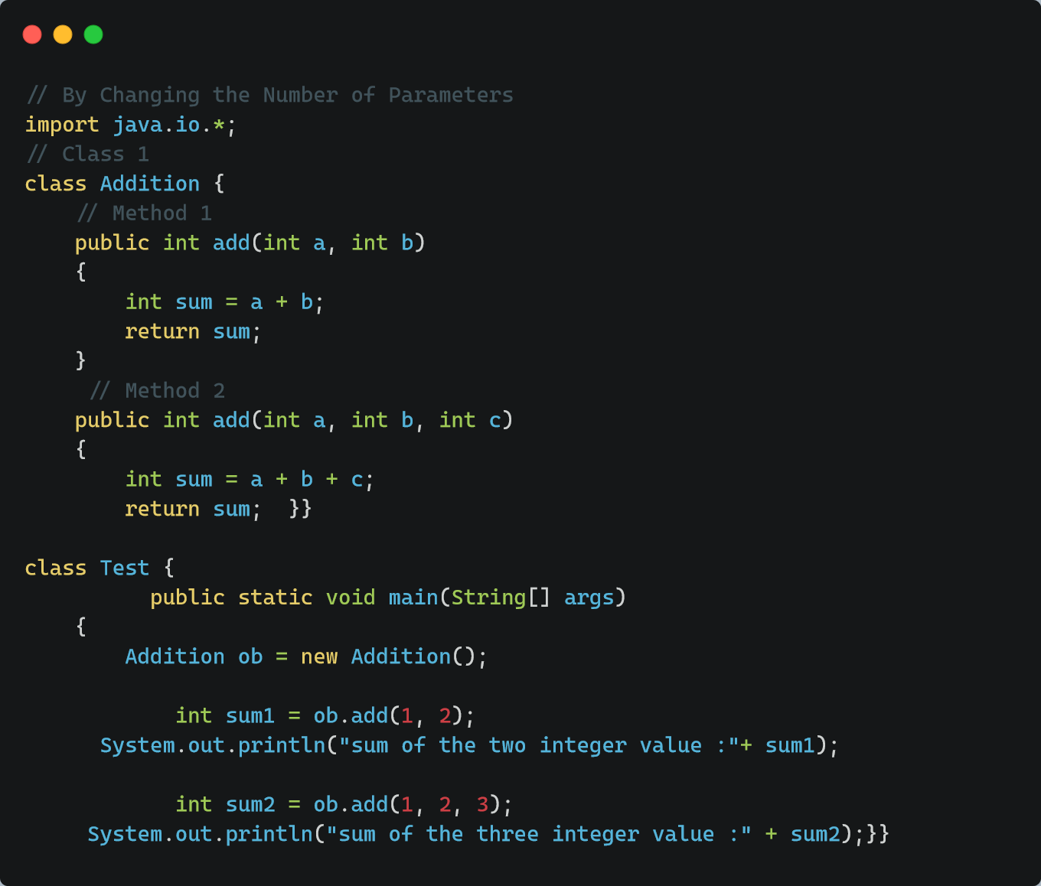
The number of parameters in two methods.

Slide 15
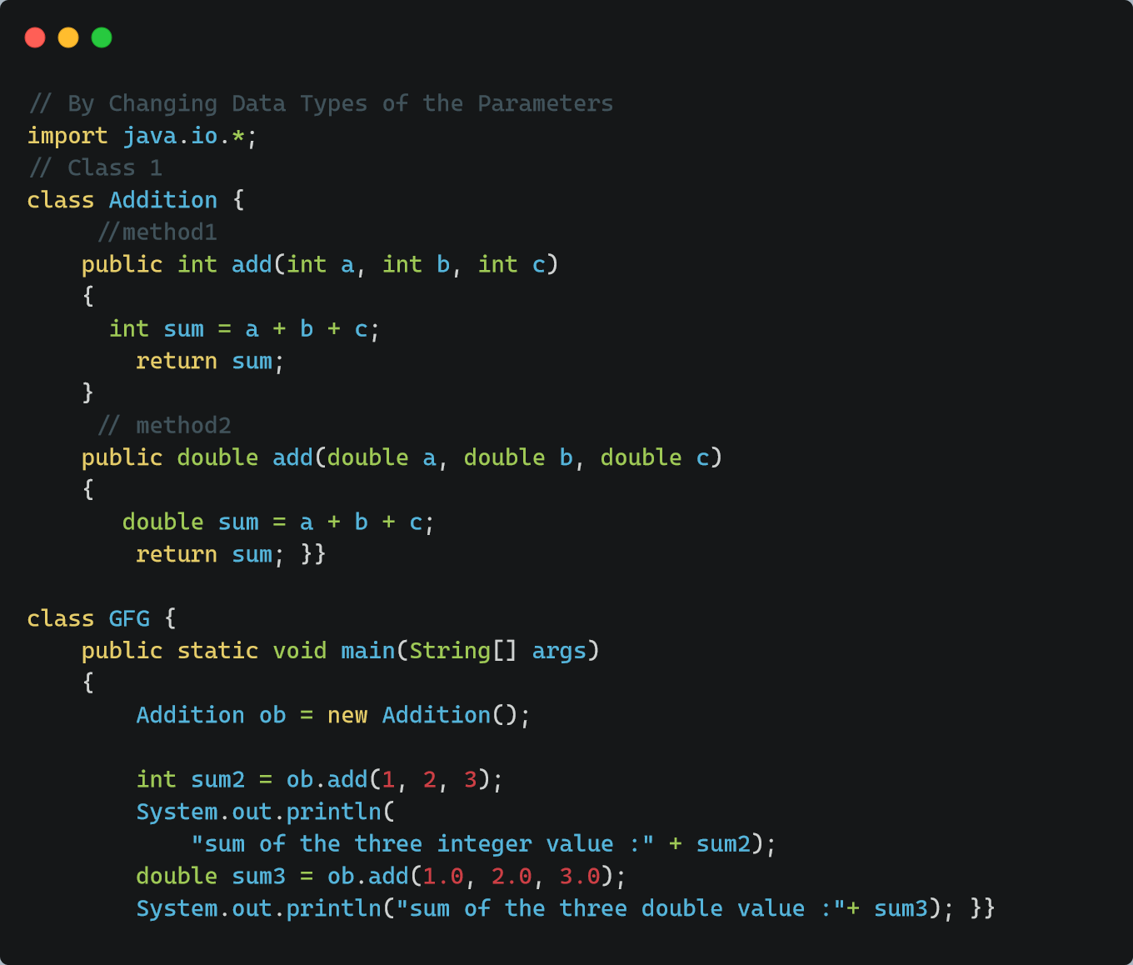
2.The data types of the parameters of methods.

Slide 16
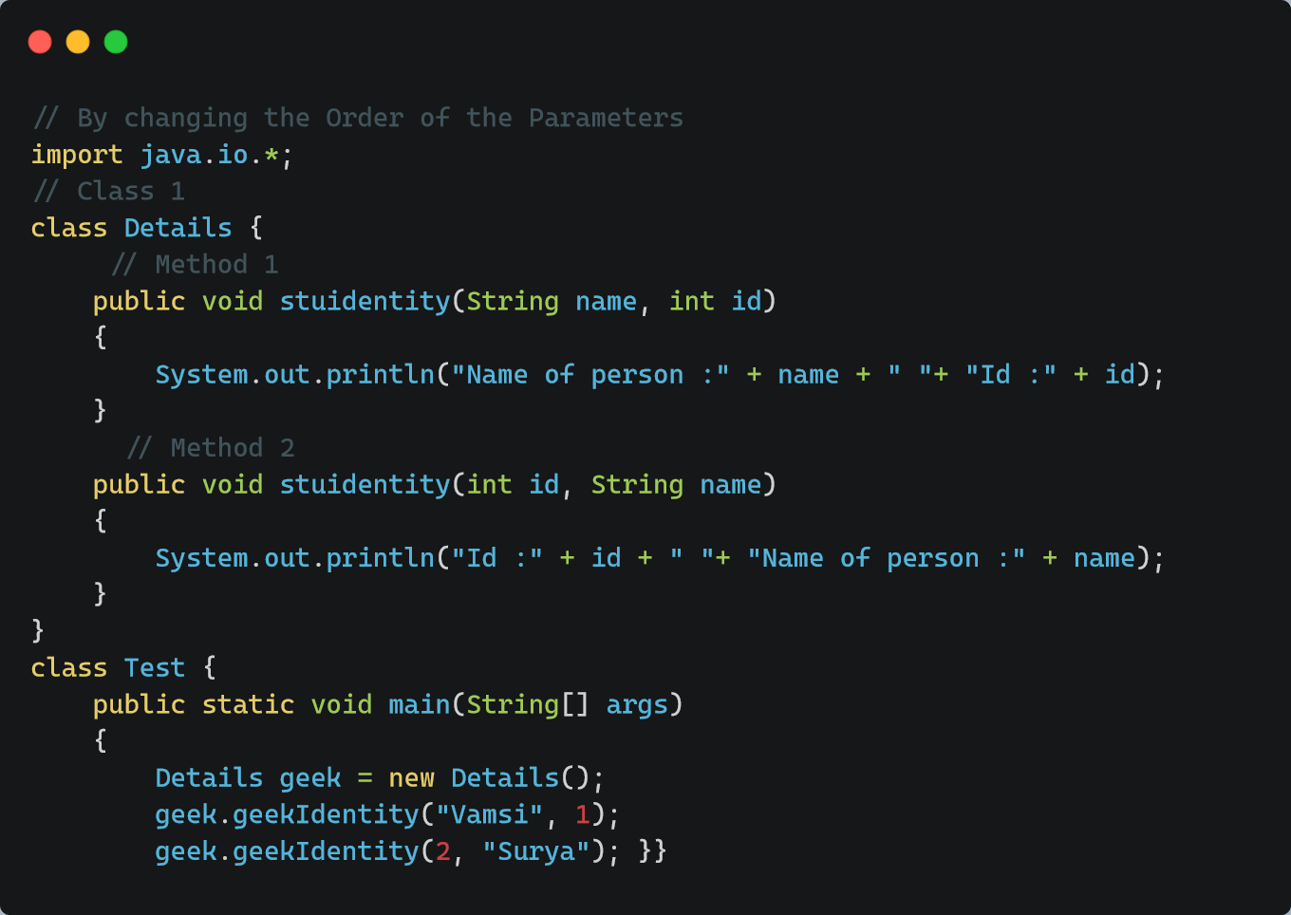
3.The Order of the parameters of methods

Slide 17
Thank You

